Slide 1
Wireless Sensor Networks

Slide 2
Overview
A wireless sensor network (WSN) is a wireless network consisting of distributed autonomous devices using sensors to co-operatively monitor physical or environmental conditions, such as temperature, sound, vibration, pressure, motion or pollutants, at different locations.

Slide 3
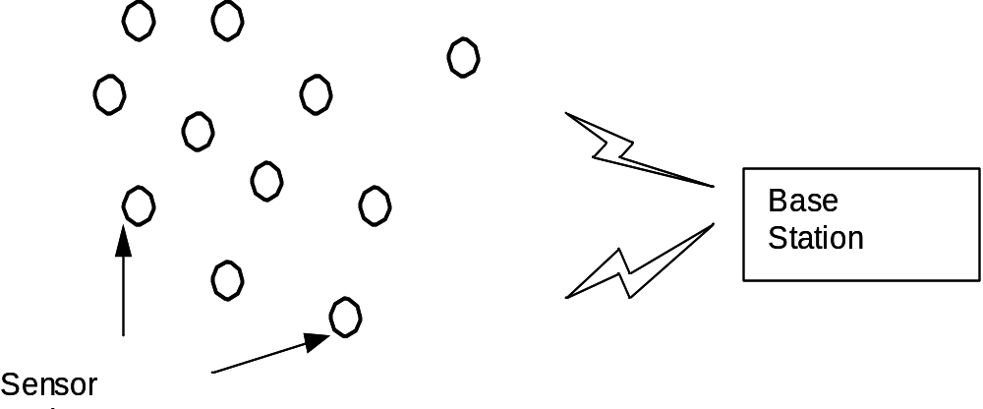
Components
A Wireless Sensor Network (WSN)
consists of base stations and a number
of wireless sensor nodes.

Slide 4
Uses
Military and national security application
Environment monitoring
Traffic surveillance
Medical application

Slide 5
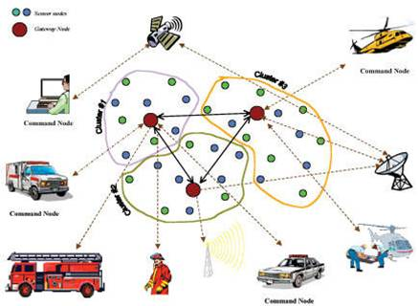

Slide 6
Problems & Issues
These days WSNs are widely used. Infact generation has migrated towards Wireless Networks, due to its easy implementation and management. Wireless Sensor Networks have many issues such as Energy losses, Security issues, Hardware limitation, Coverage problems, Fault tolerance issues. The most significant problem is Battery Management, because WSNs’ nodes working on batteries (DC), instead of (AC). Its not easy to deal batteries in bad-weather / harsh environments.

Slide 7
Open Issues in WSNs
Wireless Sensor Networks have many issues of security attacks, packet drops, high power consumptions, low battery backup and connectivity problems but major issue is providing Quality Service in harsh environments, where sensor nodes become challenging to deal.

